Slide 1

IP PACKET
Header + DATA (PAYLOAD)

Slide 2
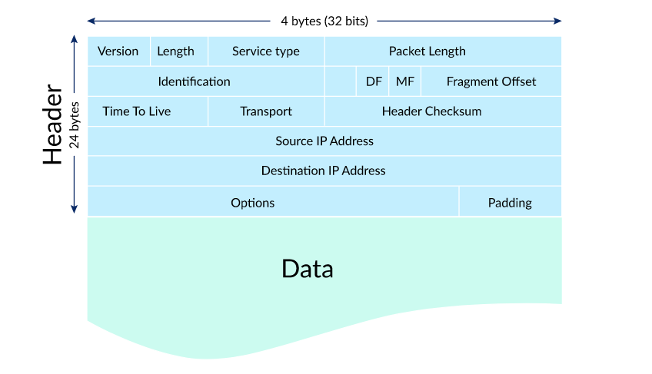




Slide 3
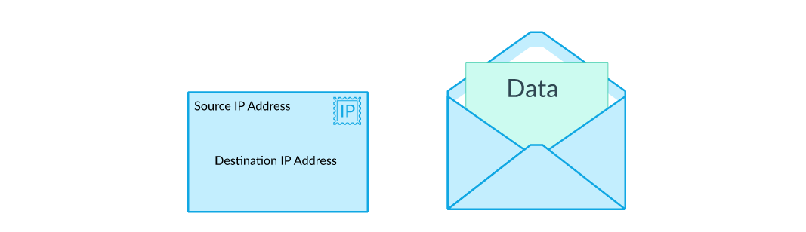
You can think of IP packets like postal letters: the header is the envelope with all the routing information that's needed by the post office, and the payload is the letter that's read only by the recipient.

Slide 4
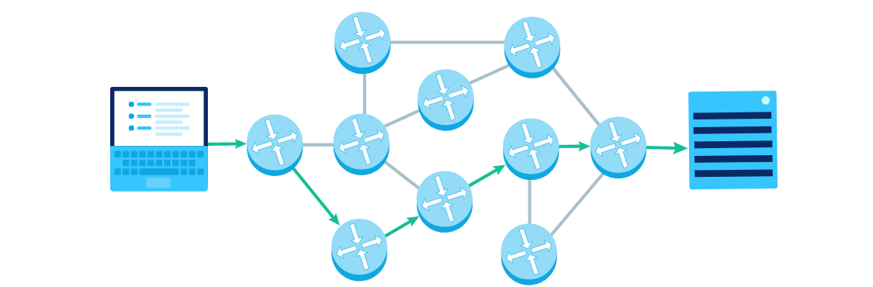
STEPS HOW PACKET IS SENT?

Slide 5
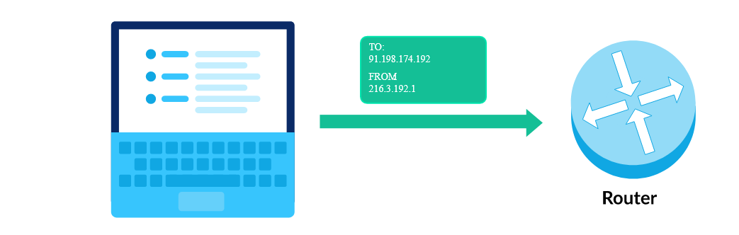
Step 1: Send packet to router

Slide 6
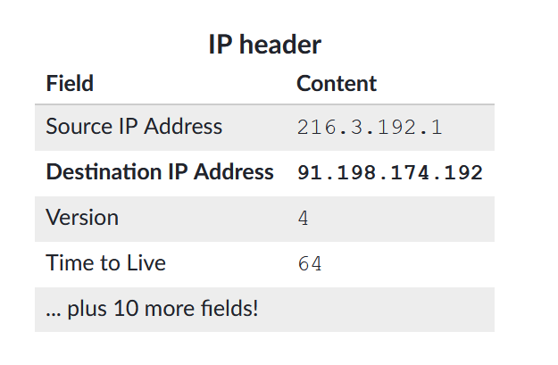
Step 2: Router receives packet
When the router receives a packet, it looks at its IP header. The most important field is the destination IP address, which tells the router where the packet wants to end up.

Slide 7
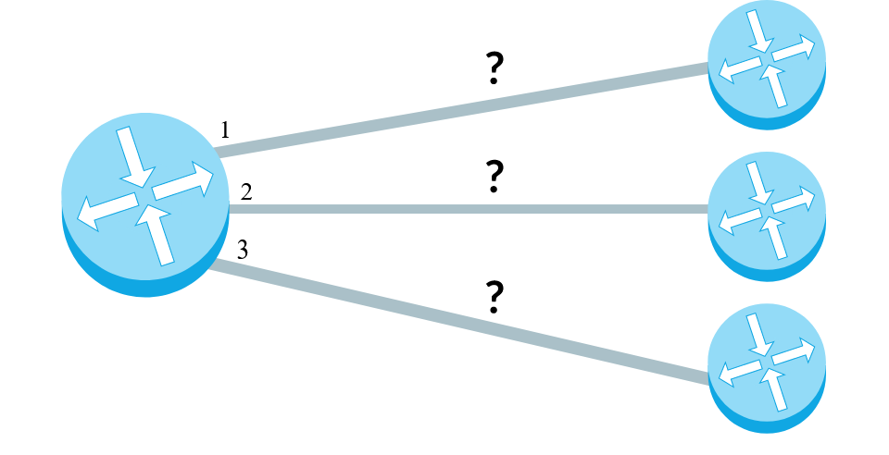
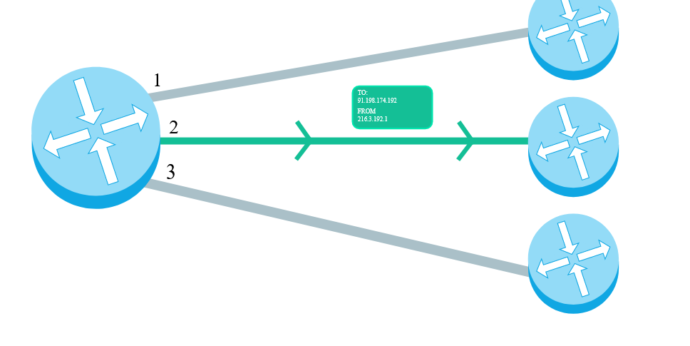
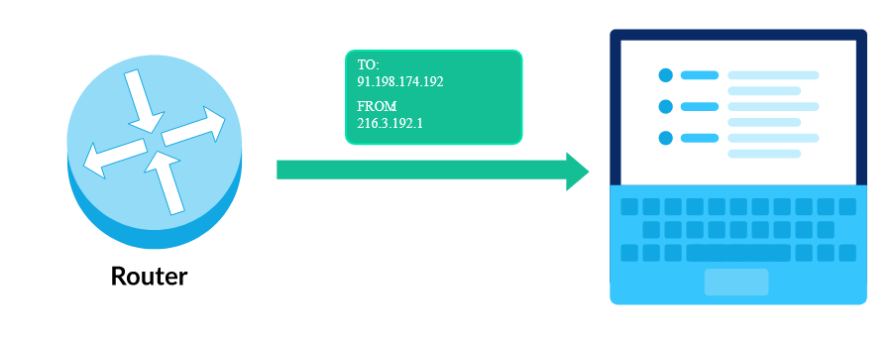
Step 3: Router forward's packet
The router has a forwarding table that helps it pick the next path based on the destination IP address. That table does not have a row for every possible IP address; there are 2322322, start superscript, 32, end superscript possible IP addresses, and that's far too much to store. Instead, the table has rows for IP address prefixes.

Slide 8
PRACTICE QUESTIONS
https://www.khanacademy.org/computing/computers-and-internet/xcae6f4a7ff015e7d:the-internet/xcae6f4a7ff015e7d:routing-with-redundancy/e/internet-packets-and-routing-protocol

Slide 9
KEYPOINTS
1. Connectionless
2. Datagram Service
Header (20-60 B)
+
Payload
(0-65515)
65515 (data)+20(min header)= 65535 B =2^16
Pure Data=65515

Slide 10
FEILDS
1. Ver: 4 bits→ 0100→ denotes Version 4→ 0000-1111 → 0000,0001,0010,0011,0100,0101,….1111
2. HLEN: 4 bits → Header length of IP Paacket
Eg. 1: If u received data of 500B it means Pure Payload= 500-20=480B
Eg.2 : How to identify the header length of a packet received is 1010. How many bytes should be there of HLEN in the received packet?
HLEN=20 to 60 B
HLEN Given = 1010 → Decimal of 1010 →10
But HLEN should be 20-60B; then we use multiply by 4 method. 10*4=40B ← HLEN.
HLEN given value should not be from 0 to 4 as it has less than 20B. So invalid.

Slide 11
3. Type of Service: Differentiated Services Code Point (DSCP) in IP V4 whereas Traffic Class in IP V6.
P | P | P | D | T | R | C | O
Reserved
Precedence (Priority) –value 0/1
Delay – 1 for fast service otherwise 0
Throughput- rate of transfer more then 1 otherwise 0
Reliability – no packet drop, reliability high
Cost- follows shortest path (1) otherwise 0
This reserved bit is used for DSCP (0-5 bits) + Explicit Congestion Notification (ECN) (6-7)
If the value of ECN is 11 it means it sends notification to sender that there is congestion.

Slide 12


TIME TO LIVE
256

Slide 13






Tells the number of fragmented packet
Fragmented data
No Fragmented data
To identify the fragmented data
No. of bytes ahead of this.

